Slide 1



An Ontological Lens on Attack Trees:
Semantics, Cybersecurity, and Services (SCS)
Faculty of Electrical Engineering, Mathematics, and Computer Science (EEMCS)
Toward Adequacy and interoperability
Ítalo Oliveira, University of Twente & Y.digital
Stefano Nicoletti, University of Twente
Mattia Fumagalli, Free University of Bozen-Bolzano
Gal Engelberg, University of Haifa
Dan Klein, Accenture EMEA
Giancarlo Guizzardi, University of Twente
https://italojsoliveira.github.io

Slide 2
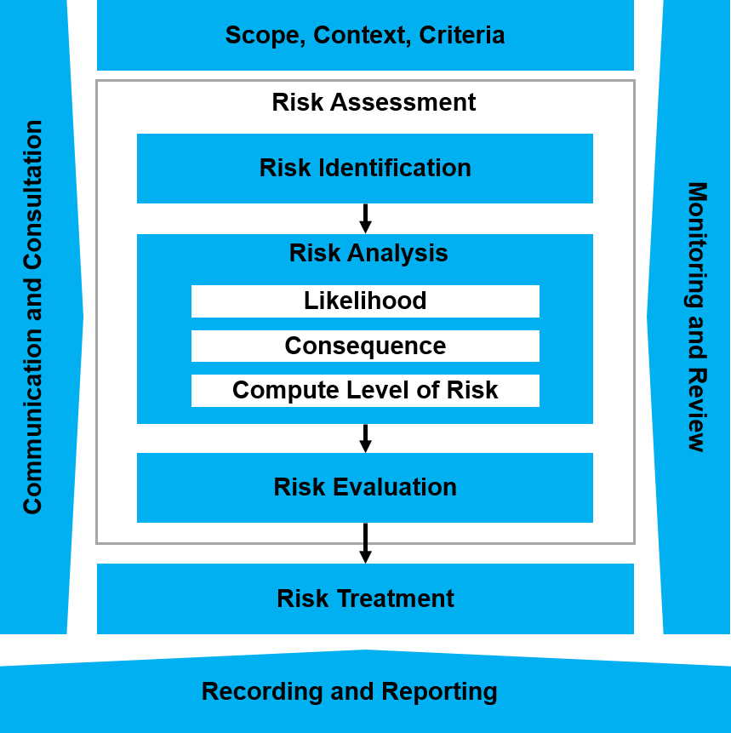
Risk Management Process - ISO 31000

Slide 3
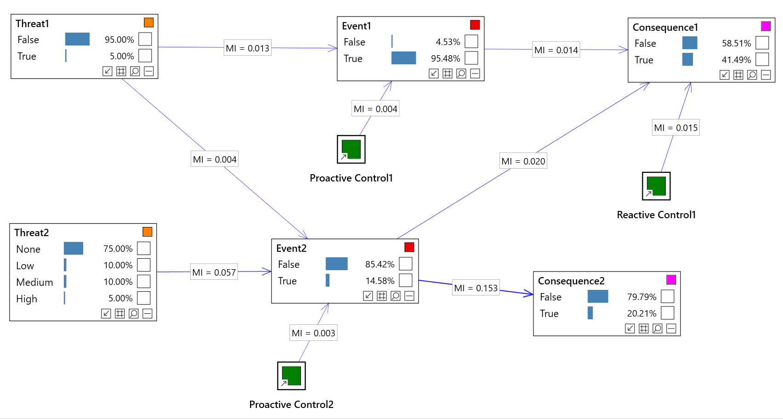
Risk Modeling with Bayesian Networks
https://www.bayesserver.com/docs/modeling/risk

Slide 4
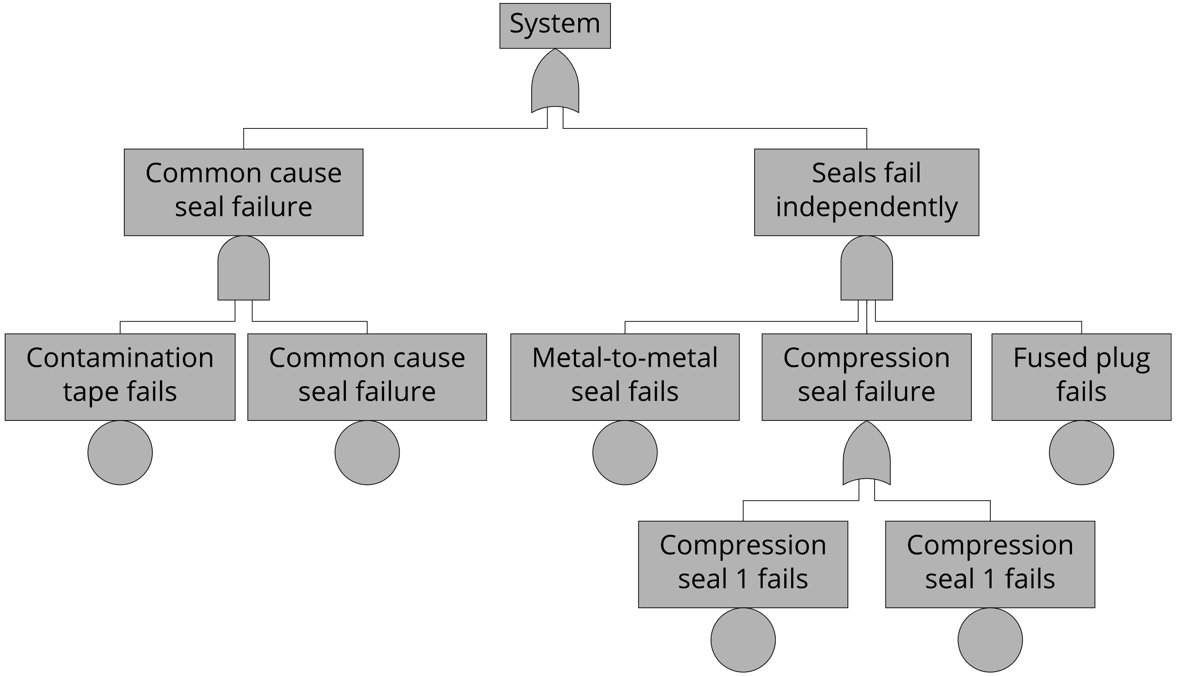
Fault Tree: How can a system fail?
M. Stamatelatos, W. Vesely, J. Dugan, J. Fragola, J. Minarick, and J. Railsback: Fault tree handbook with aerospace applications, 2002

Slide 5
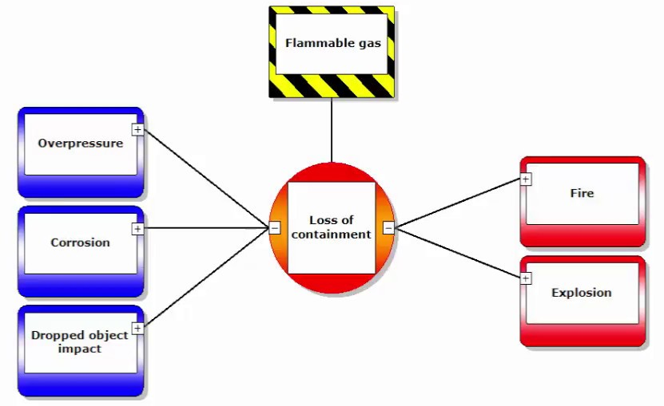
Bowtie diagram

Slide 6
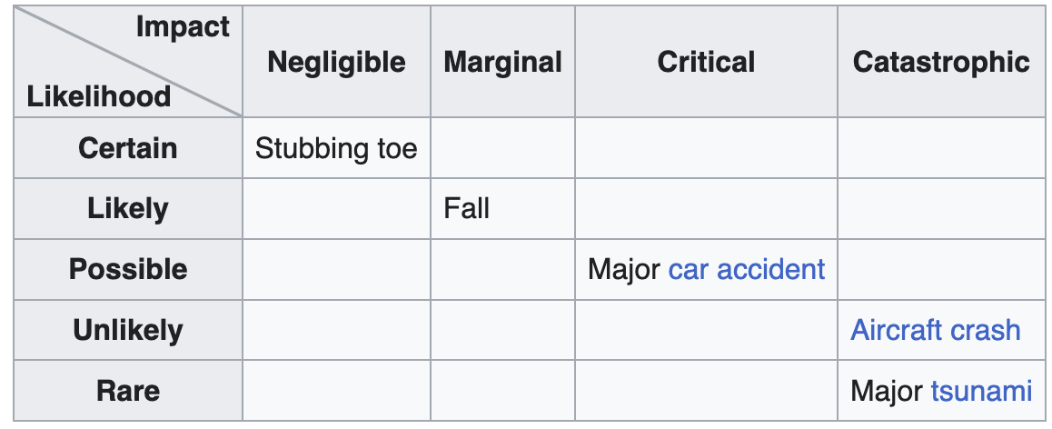
Risk Matrix for Risk Assessment

Slide 7
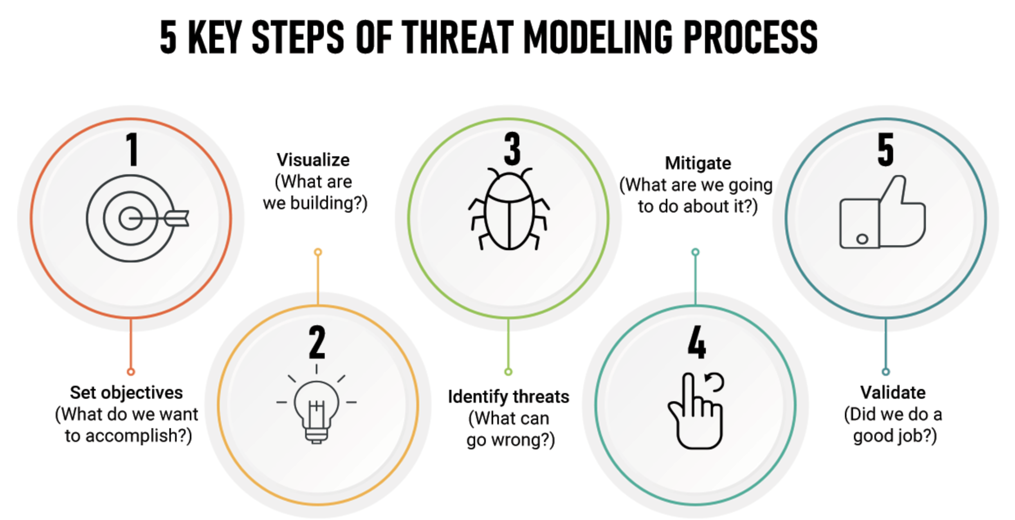
securiCAD – https://www.bitcyber.com.sg/foreseeti-securicad
ThreatModeler – https://www.threatmodeler.com
IriusRisk – https://www.iriusrisk.com
OWASP Threat Dragon – https://owasp.org/www-project-threat-dragon
Microsoft Threat Modeling Tool – https://www.microsoft.com/en-us/securityengineering/sdl/threatmodeling
CORAS language – https://coras.sourceforge.net/index.html
Notes:
https://www.spiceworks.com/it-security/network-security/articles/what-is-threat-modeling-definition-process-examples-and-best-practices/

Slide 8
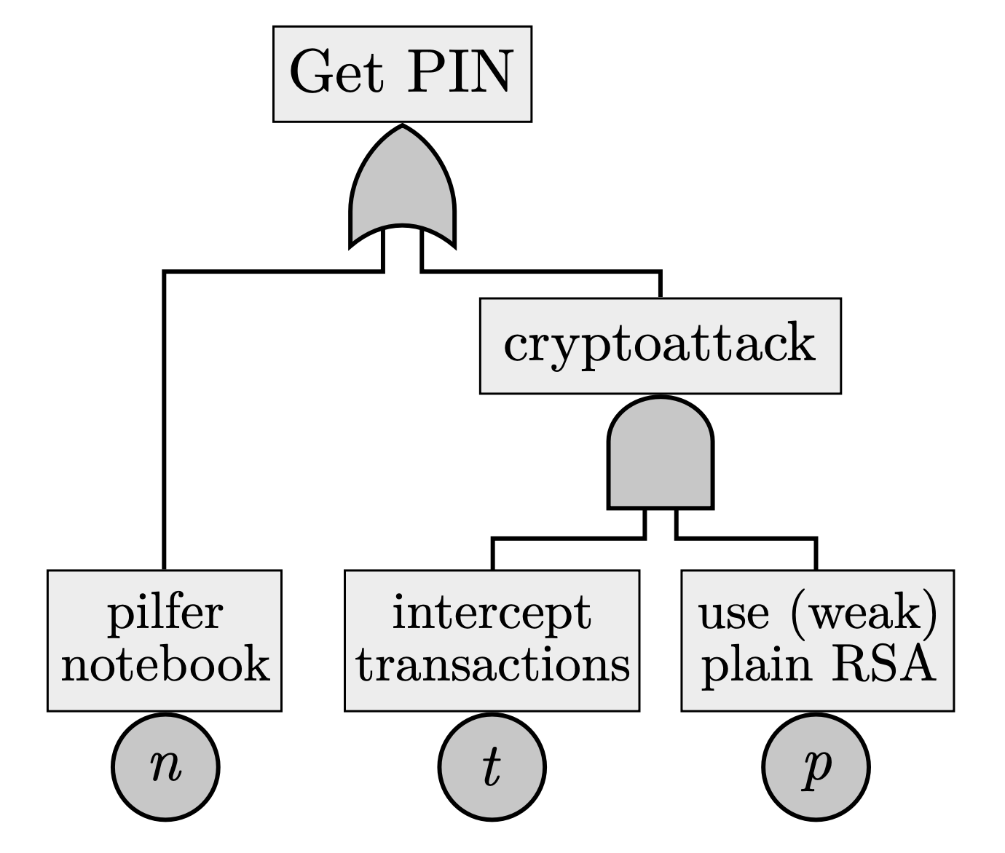
Attack Trees are rooted Directed Acyclic Graphs with typed nodes.

Slide 9
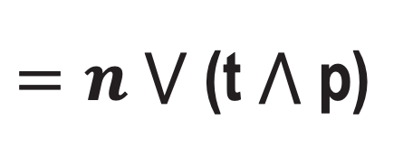




Attack Trees are rooted Directed Acyclic Graphs with typed nodes.
$$⋁$$
$=n ⋁$ (t $⋀$ p)
$$n$$
$$⋀$$
$=$(t $⋀$ p)
t
p
Successful attacks: {n}, {t, p}, {n, t, p}
Minimal (successful) attacks: {n}, {t, p}
Security metrics are value assignments to attacks.

Slide 10
Attack trees offer three important services:
CONCEPTUAL MODELING capabilities for representing security risk management scenarios.
Qualitative analysis to find root causes and minimal conditions of successful attacks.
Quantitative analysis to compute security metrics, such as minimal time and cost among all attacks.
Kumar, R. et al. (2018). Effective Analysis of Attack Trees: A Model-Driven Approach. In: Russo, A., Schürr, A. (eds) Fundamental Approaches to Software Engineering. FASE 2018. Lecture Notes in Computer Science, vol 10802. Springer, Cham. https://doi.org/10.1007/978-3-319-89363-1_4

Slide 11
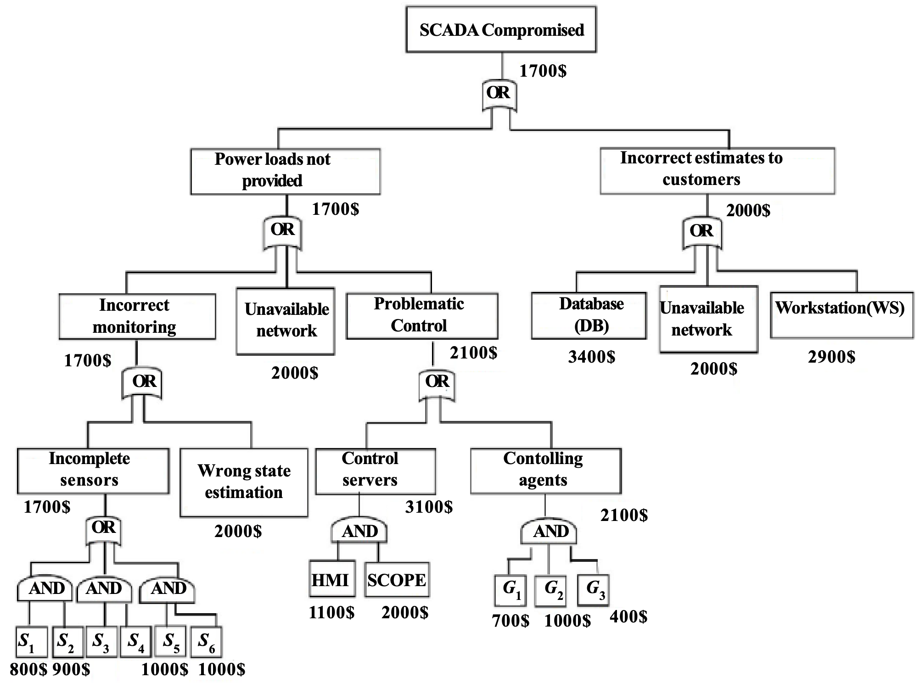
El Bouchti A, Haqiq A. Modeling cyber-attack for SCADA systems using CoPNet approach. In: 2012 IEEE International Conference on Complex Systems (ICCS). IEEE; 2012. p. 1-6.

Slide 12
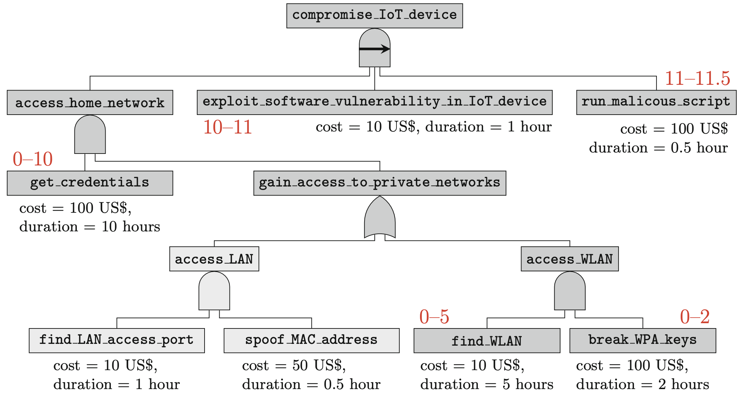
Kumar, R. et al. (2018). Effective Analysis of Attack Trees: A Model-Driven Approach. In: Russo, A., Schürr, A. (eds) Fundamental Approaches to Software Engineering. FASE 2018. Lecture Notes in Computer Science, vol 10802. Springer, Cham. https://doi.org/10.1007/978-3-319-89363-1_4

Slide 13
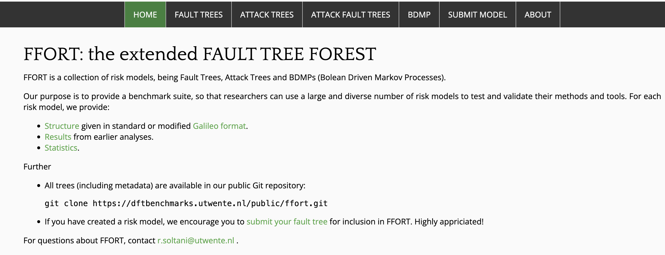
Website: https://dftbenchmarks.utwente.nl

Slide 14
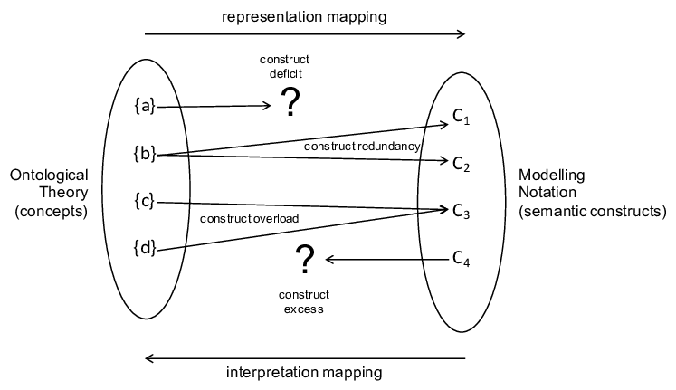
Ontological Analysis Method

Slide 15
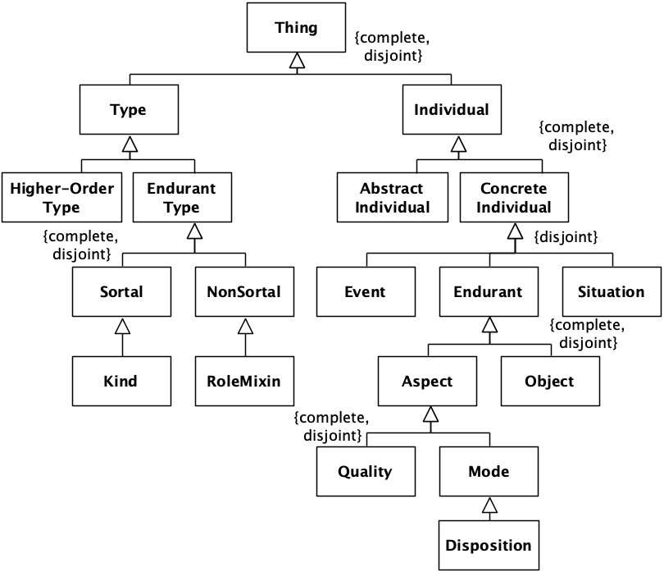
A Fragment of the Unified Foundational Ontology

Slide 16
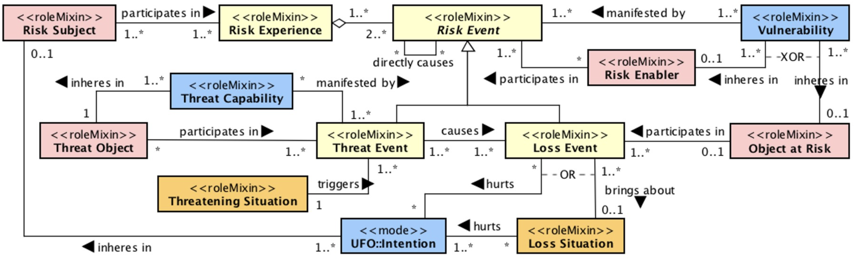
The Common Ontology of Value and Risk
Sales, T.P., Baião, F., Guizzardi, G., Almeida, J.P.A., Guarino, N., Mylopoulos, J. (2018). The Common Ontology of Value and Risk. In: Trujillo, J., et al. Conceptual Modeling. ER 2018. Lecture Notes in Computer Science(), vol 11157. Springer, Cham. https://doi.org/10.1007/978-3-030-00847-5_11

Slide 17
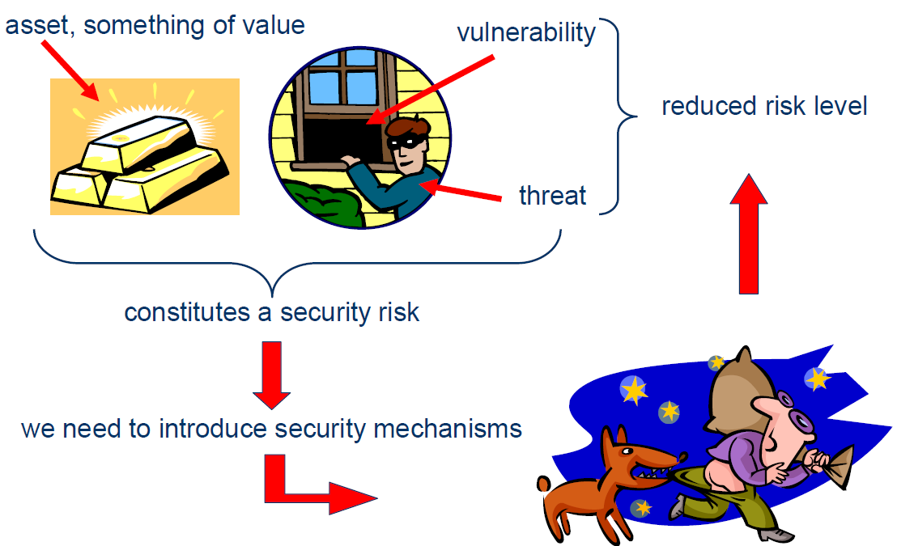
Elements of Value, Risk, and Security

Slide 18




Elements of Value, Risk, and Security
Subjects
Assets
Goals and intentions
Capabilities and vulnerabilities
Events and situations
Threats and attackers
Chances and impacts

Slide 19
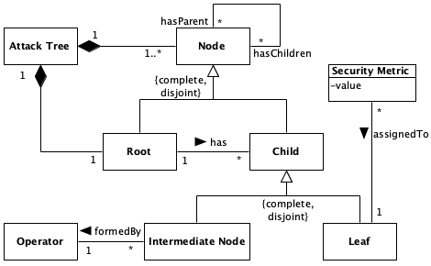
Attack Tree Metamodel

Slide 20
Semantic Overload
ROOT: “Goal”, “Top Level Event”.
NODE: “steps”, “attack steps”, “subgoals”, “undesired events”, “ways of achieving the goal”, “attacker actions”.
EVENT? SITUATION?
EVENT? WHAT HAPPENED?
A single or multiple attackers?
OBJECT?
OBJECT?
EVENT TYPE?
SITUATION?
SITUATION?

Slide 21
Semantic Overload
The node description is highly overloaded because, without good descriptions, we do not know what we are talking about.
Consequently, the utility of calculating minimal conditions of successful attacks and security metrics depends entirely on naming nodes well enough.

Slide 22

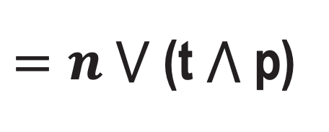
Semantic Overload
$=n ⋁$ (t $⋀$ p)
What is the relationship between “intercept transactions” and “use (weak) plain RSA”? And what is the relationship between them and “cryptoattack”?
Mereological relation between events?
Token Causation?
Type Causation (regularities)?
Parthood of Intention (Intrinsic Aspect)?
Event Impact on Goals?
$=$(t $⋀$ p)

Slide 23
Ontological Incompleteness
A theory of risk should explain why a successful attack occurs, who is affected, and how they are affected, which objects participate in attacks, the role and features of capabilities and vulnerabilities in certain situations.

Slide 24

Ontological Incompleteness
A minimal successful attack out of 24 total nodes:
“SCADA Compromised” (root),
“Incorrect estimates to customers” (intermediate node),
“Database” (leaf).

Slide 25
Limited Modeling Guidance
AT users have to:
come up with the attacker’s final goal (root node) and start to
branch it into intermediate nodes until
they reach “basic attack steps”.
HOW?
HOW GOOD?

Slide 26
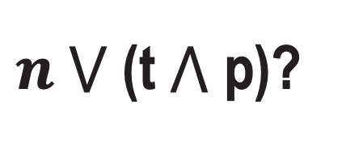
Semantic Interoperability Issues
Data Interoperability
Technique Interoperability
Human Communication
AT Identity Crisis: When are two ATs the same?
$n ⋁$ (t $⋀$ p)?

Slide 27
Incremental Solutions: Extending the Metamodel
Dynamic Attack Trees
Attack-defense Trees
Agents

Slide 28
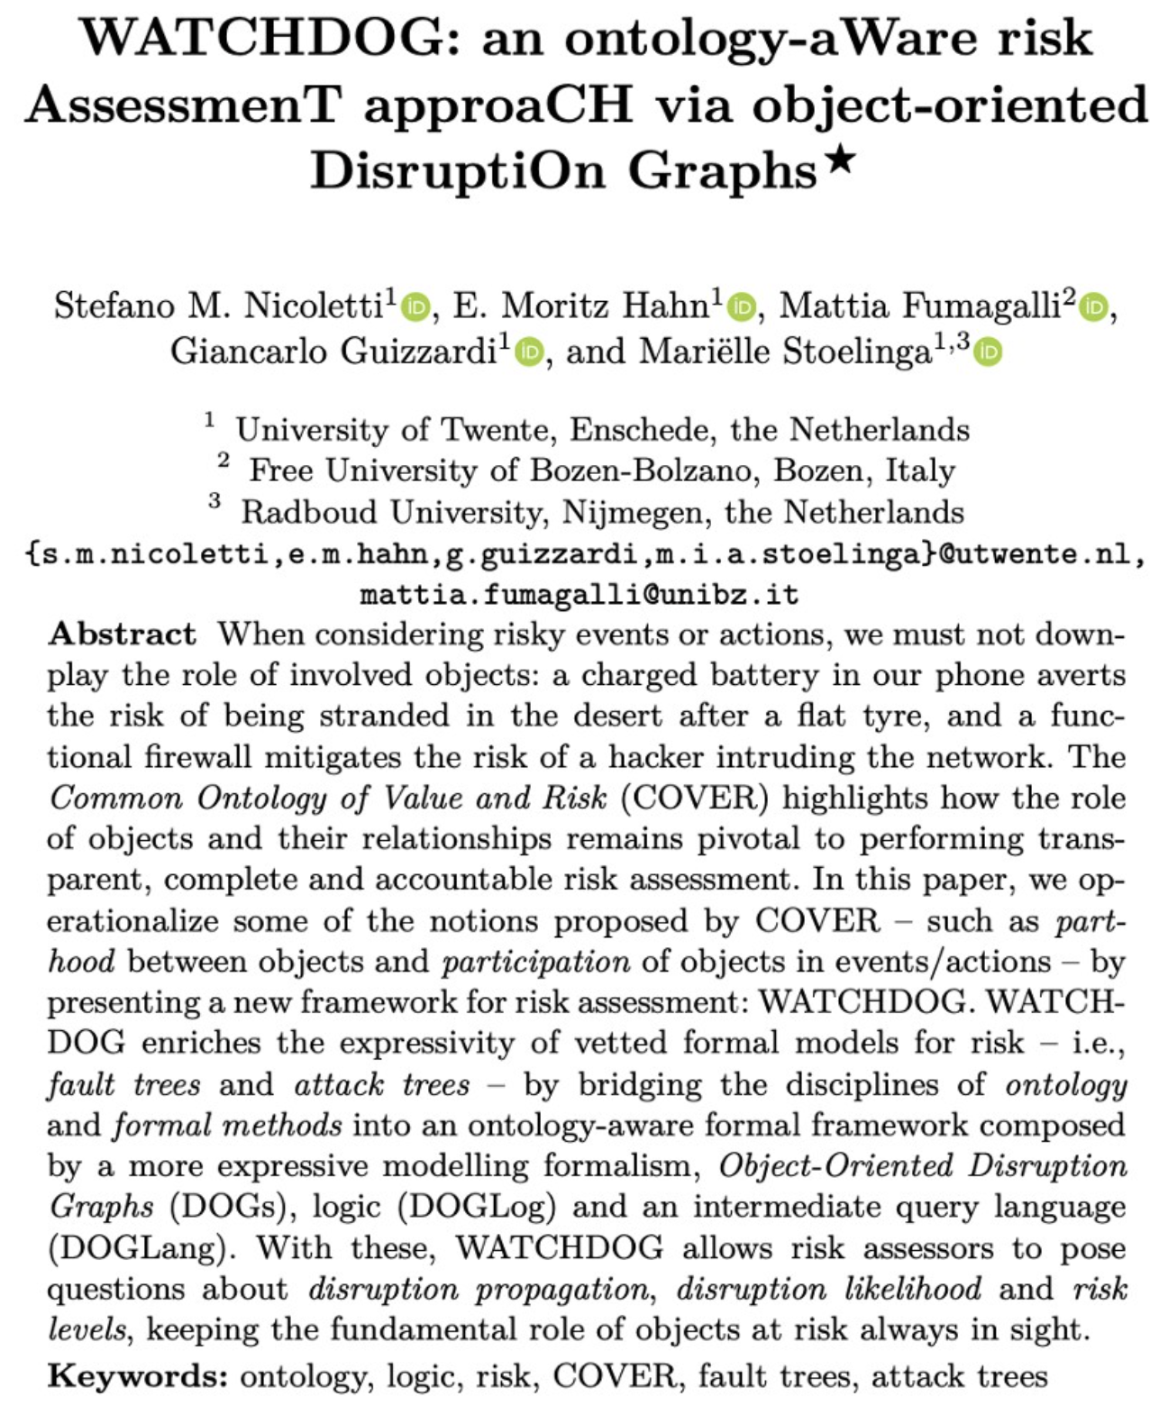

Slide 29
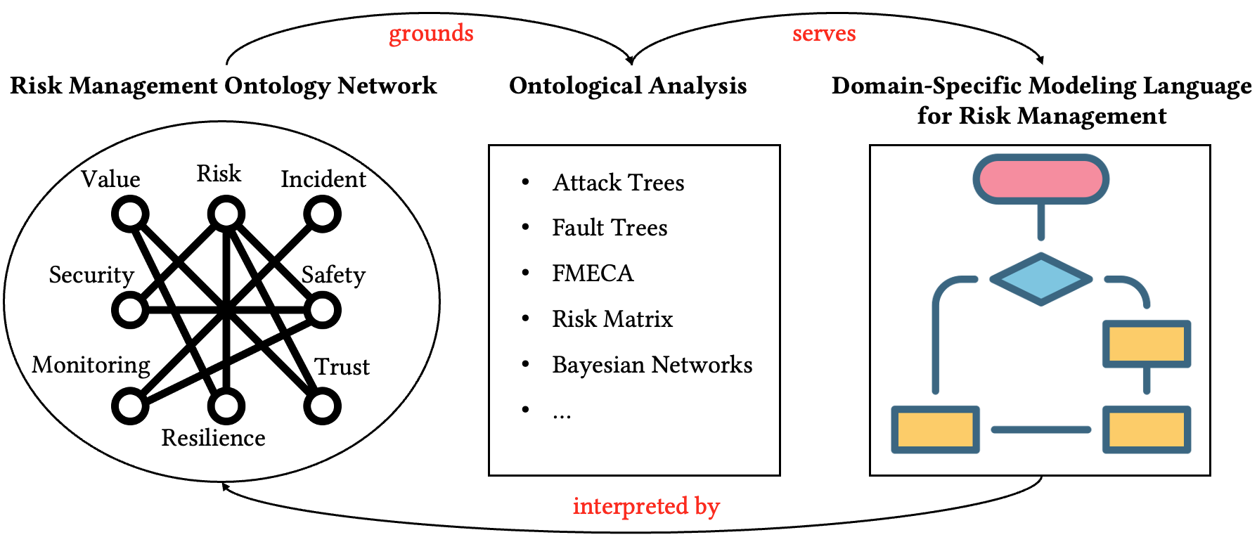
A Broad, Systematic Solution: Ontology-based Modeling for Risk Management

Slide 30








External datasets to be integrated
DSL for risk management
Security Policy System
AT metrics computation
Bayesian analysis
Triplestore
Visual and textual interface to OWL
SPARQL
query & answer
Incident response system
Knowledge-based Chatbot

Slide 31
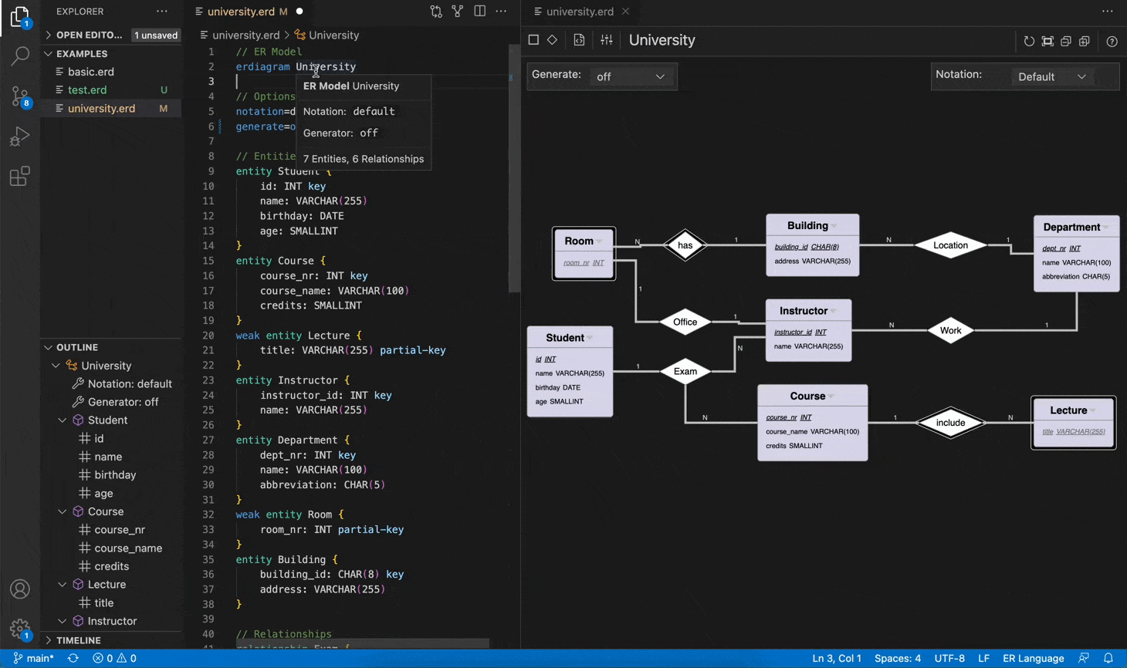
ER diagram modeling tool: https://github.com/borkdominik/bigER

Slide 32
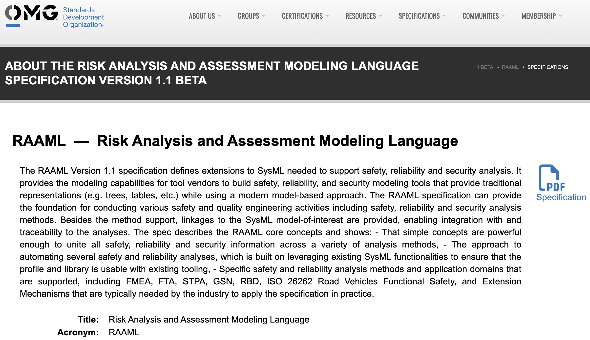

Slide 33
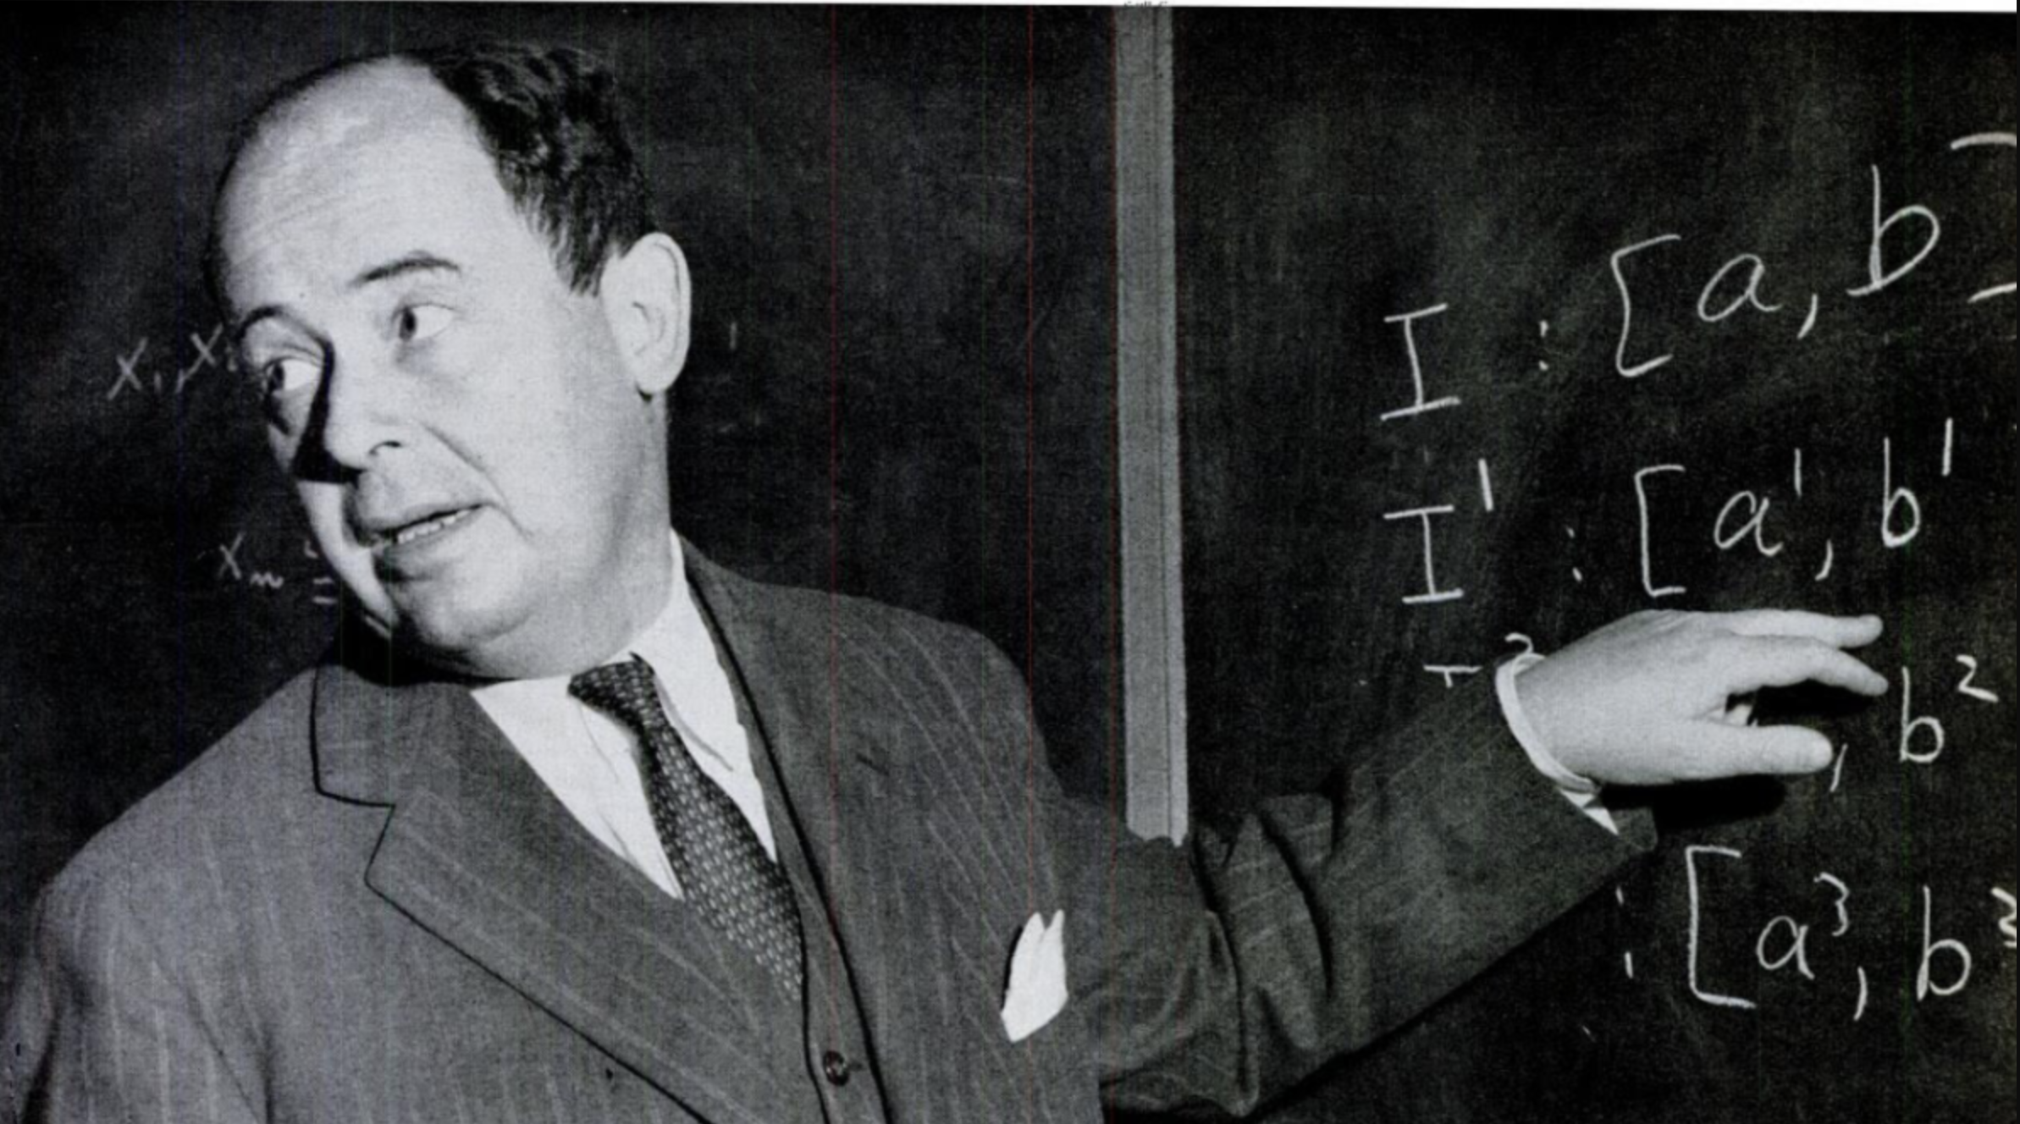
There's no sense in being precise when you don't even know what you're talking about. --- John von Neumann

Slide 34
An Ontological Lens on Attack Trees:
Semantics, Cybersecurity, and Services (SCS)
Faculty of Electrical Engineering, Mathematics, and Computer Science (EEMCS)
Toward Adequacy and interoperability
Ítalo Oliveira, University of Twente & Y.digital
Stefano Nicoletti, University of Twente
Mattia Fumagalli, Free University of Bozen-Bolzano
Gal Engelberg, University of Haifa
Dan Klein, Accenture EMEA
Giancarlo Guizzardi, University of Twente
https://italojsoliveira.github.io
.

